Slide 1


MAILOPS-CLI: A SEAMLESS COMMAND-LINE SOLUTION FOR EFFICIENT EMAIL MANAGEMENT

Slide 2


TEAM MEMBERS
ELANTHIRAYAN.E
DHIVAHAR.V
DIWAKAR.P
ARINDRAN.M
Guide Name :

Slide 3

Domain introduction
Problem statement
Existing system
Proposed system
Software tools
Architecture
Modules
Output
References
AGENDA

Slide 4
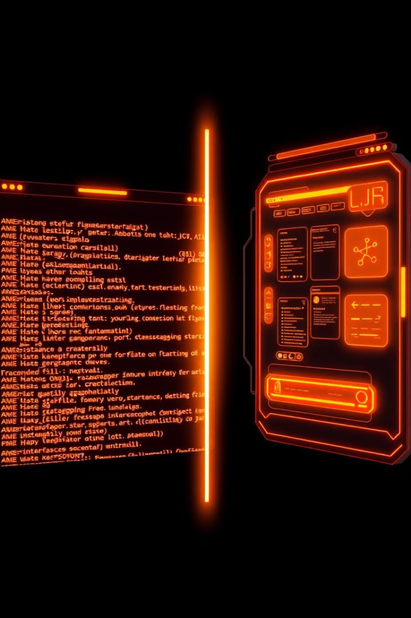
DOMAIN INTRODUCTION
Command-Line Interface (CLI): A text-based interface that enables users to interact with the system by typing commands, offering a lightweight and efficient way to execute tasks directly in the terminal or console.
Email Management: The process of organizing, sorting, and interacting with emails in an efficient and structured manner. It involves tasks such as sending, reading, sorting, and archiving emails.
Why CLI for Email?
Offers faster access without a GUI Reduces resource usage and increases productivity Enables advanced users to manage emails with greater control.

Slide 5

Problem Statement & Existing System
Inefficient Email Workflows:
1
Cluttered Inboxes: Difficulty managing and prioritizing emails due to high volumes.
Limited Automation: Existing email systems lack efficient automation for sorting, filtering, and organizing emails.
Power User Limitations: Traditional GUIs offer limited control and customization for advanced email management.
2
3
Existing System Challenges:
1
GUI Dependency: Graphical email clients are slow and resource-heavy.
Manual Processes: Email management relies heavily on manual sorting, searching, and flagging.
Basic Notification Systems: Existing tools lack advanced, customizable notifications for better user responsiveness
2
3

Slide 6
The Solution: MailOps-CLI
Command-Line Interface:
Advanced Email Organization
Efficient Workflow:
A lightweight, fast interface for managing emails without the need for a GUI.
Automates email sorting, searching, and flagging for better organization.
Allows quick access to email features (sending, reading, starring, searching) via simple commands, improving productivity.
Speed & Efficiency:
User-Friendly for All:
Resource-Friendly:
Reduce the time spent on manual email management tasks.
Tailored for both novice and advanced users with simple, intuitive commands.
Operates without consuming system resources like traditional email clients.

Slide 7

Software Tools
Technologies Used:
Node.js: JavaScript runtime for building scalable server-side applications.
JavaScript: Language used for scripting email commands.
Node mailer: Module for sending and receiving emails.
JSON: Used for storing email data and configurations locally.
CLI (Command-Line Interface): Lightweight interface for email management.
Supporting Tools:
Git: Version control for collaboration.
Visual Studio Code: Code editor for development.

Slide 8
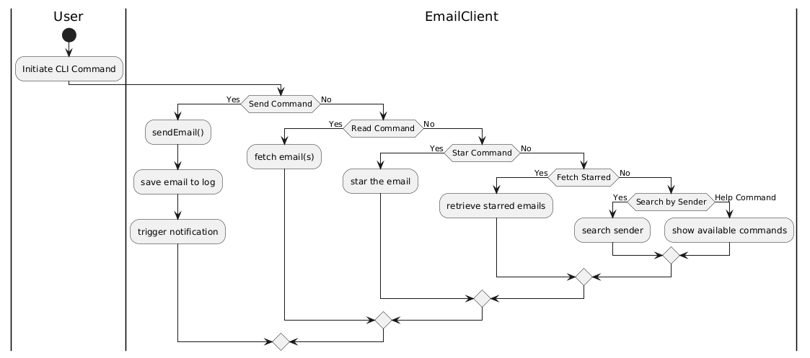
Architecture

Slide 9

Modules in MailOps-CLI
Storage Module
Stores emails and user settings locally for offline access.
Uses JSON to cache data, improving loading times and reducing server dependency.
Notification Module
Monitors inbox and alerts users to new emails.
Provides notifications directly within the CLI for quick updates.
Log Module
Maintains a log of sent emails for easy reference.
Helps track email activity and supports efficient email management.
Command Execution Module
Interprets and executes user commands like sending, reading, and starring emails.
Supports flexible filters (e.g., by date or sender) for efficient email handling.

Slide 10
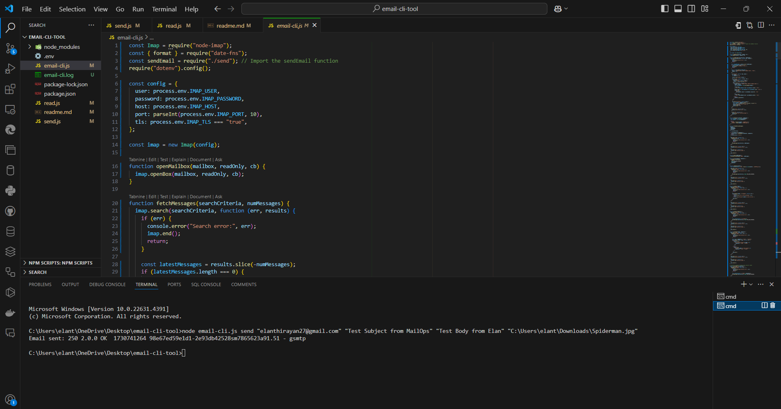
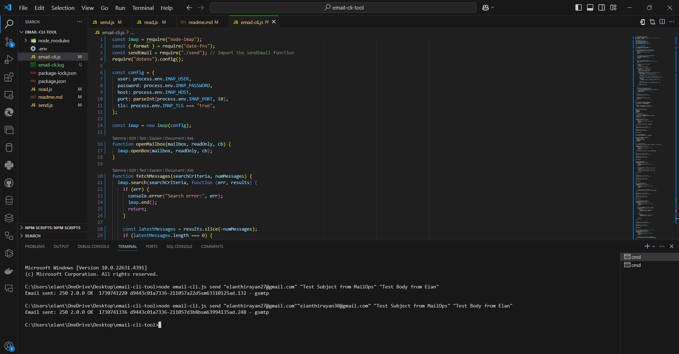
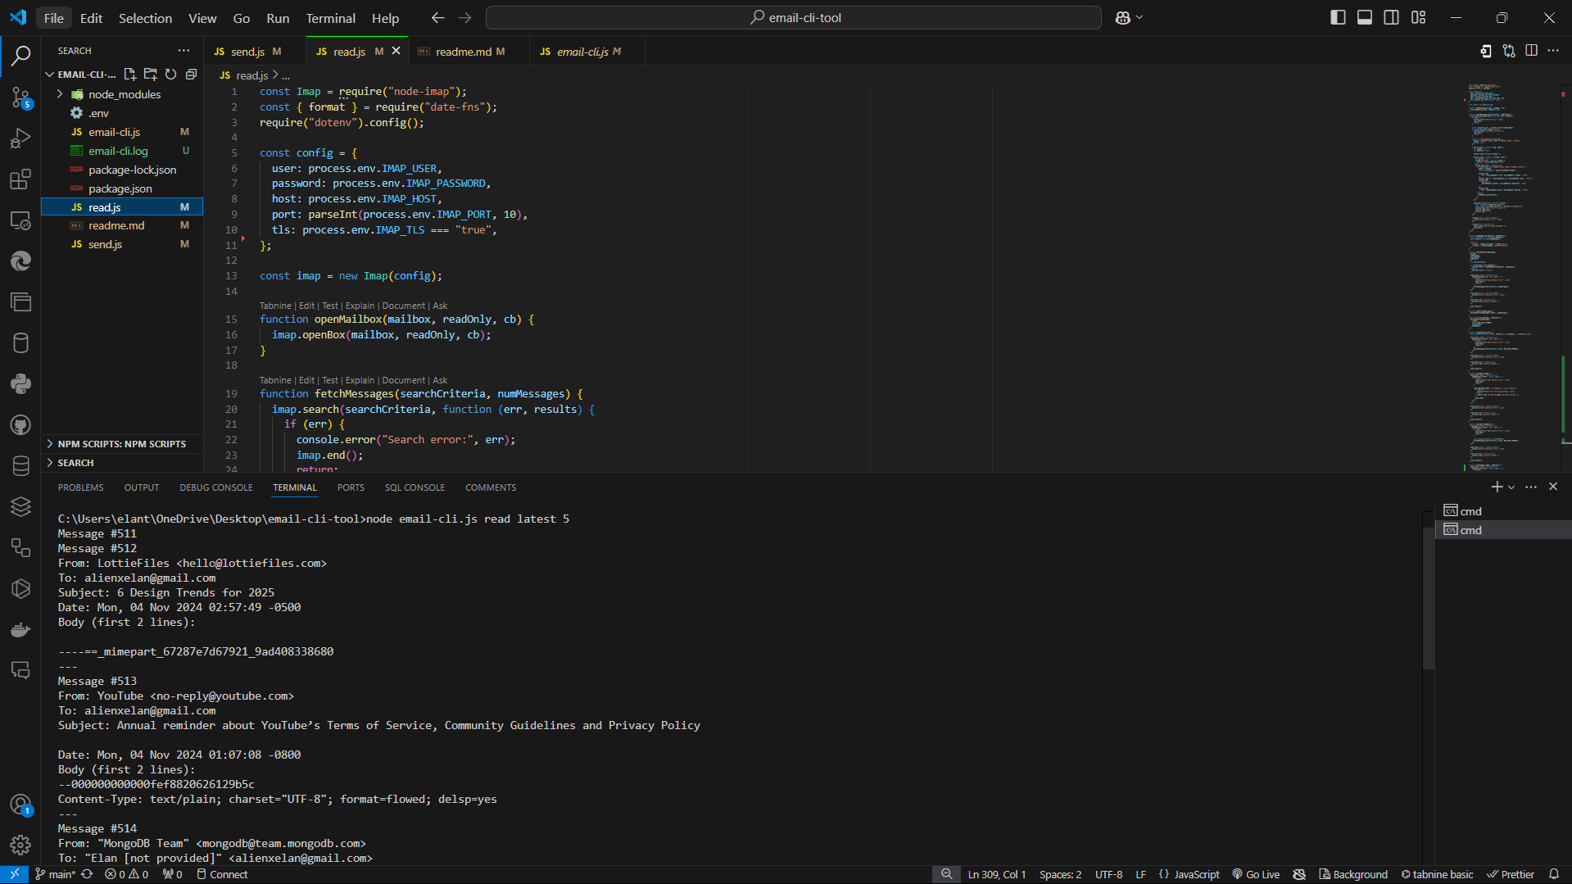
OUTPUT
SEND OPERATION WITH ATTACHMENTS
SEND OPERATION FOR SINGLE & MULTIPLE USERS
READ OPERATION LASTEST MAILS

Slide 11
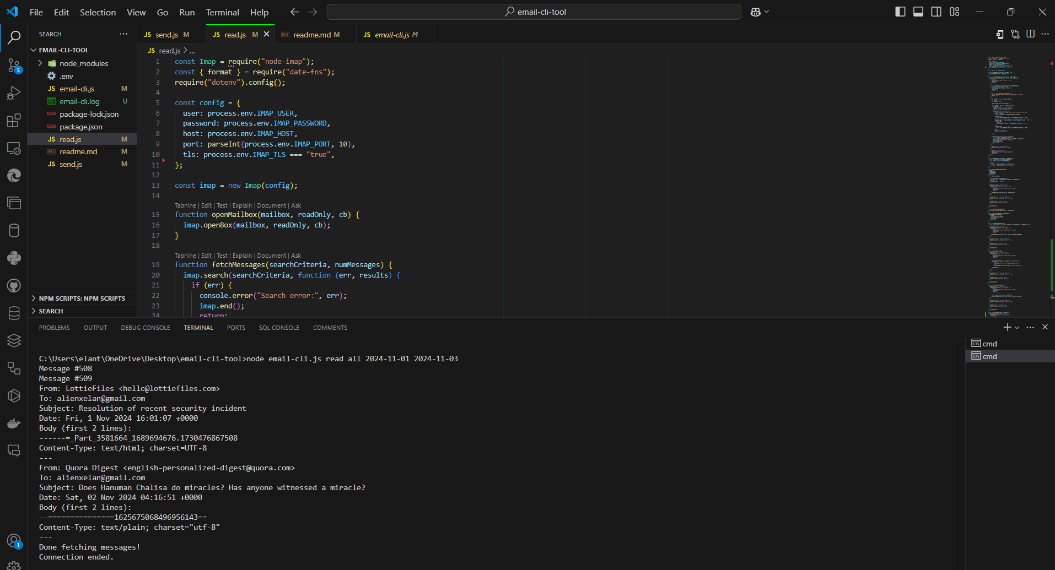
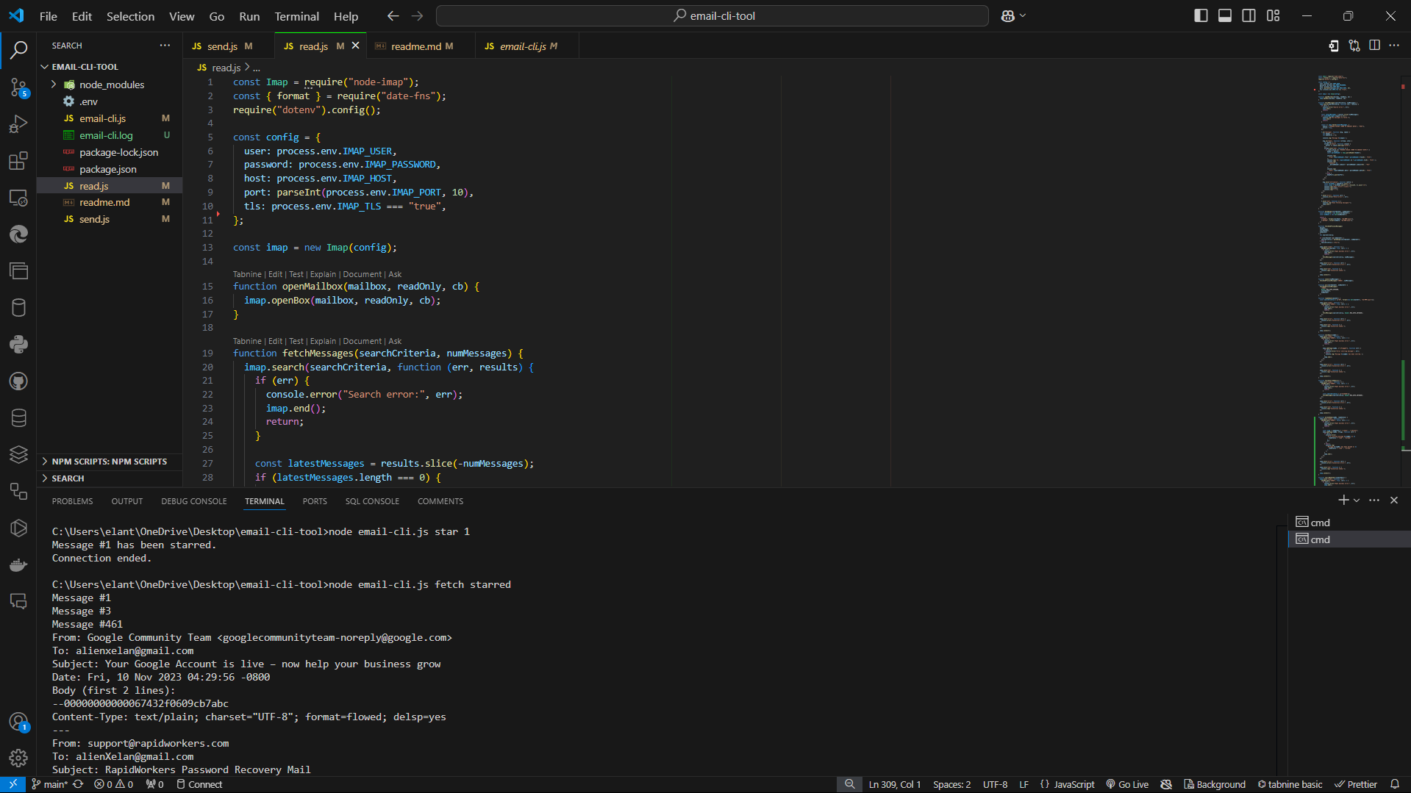
READ MAILS ON DATE FILTRATION
SET & FETCH STAR MAILS

Slide 12
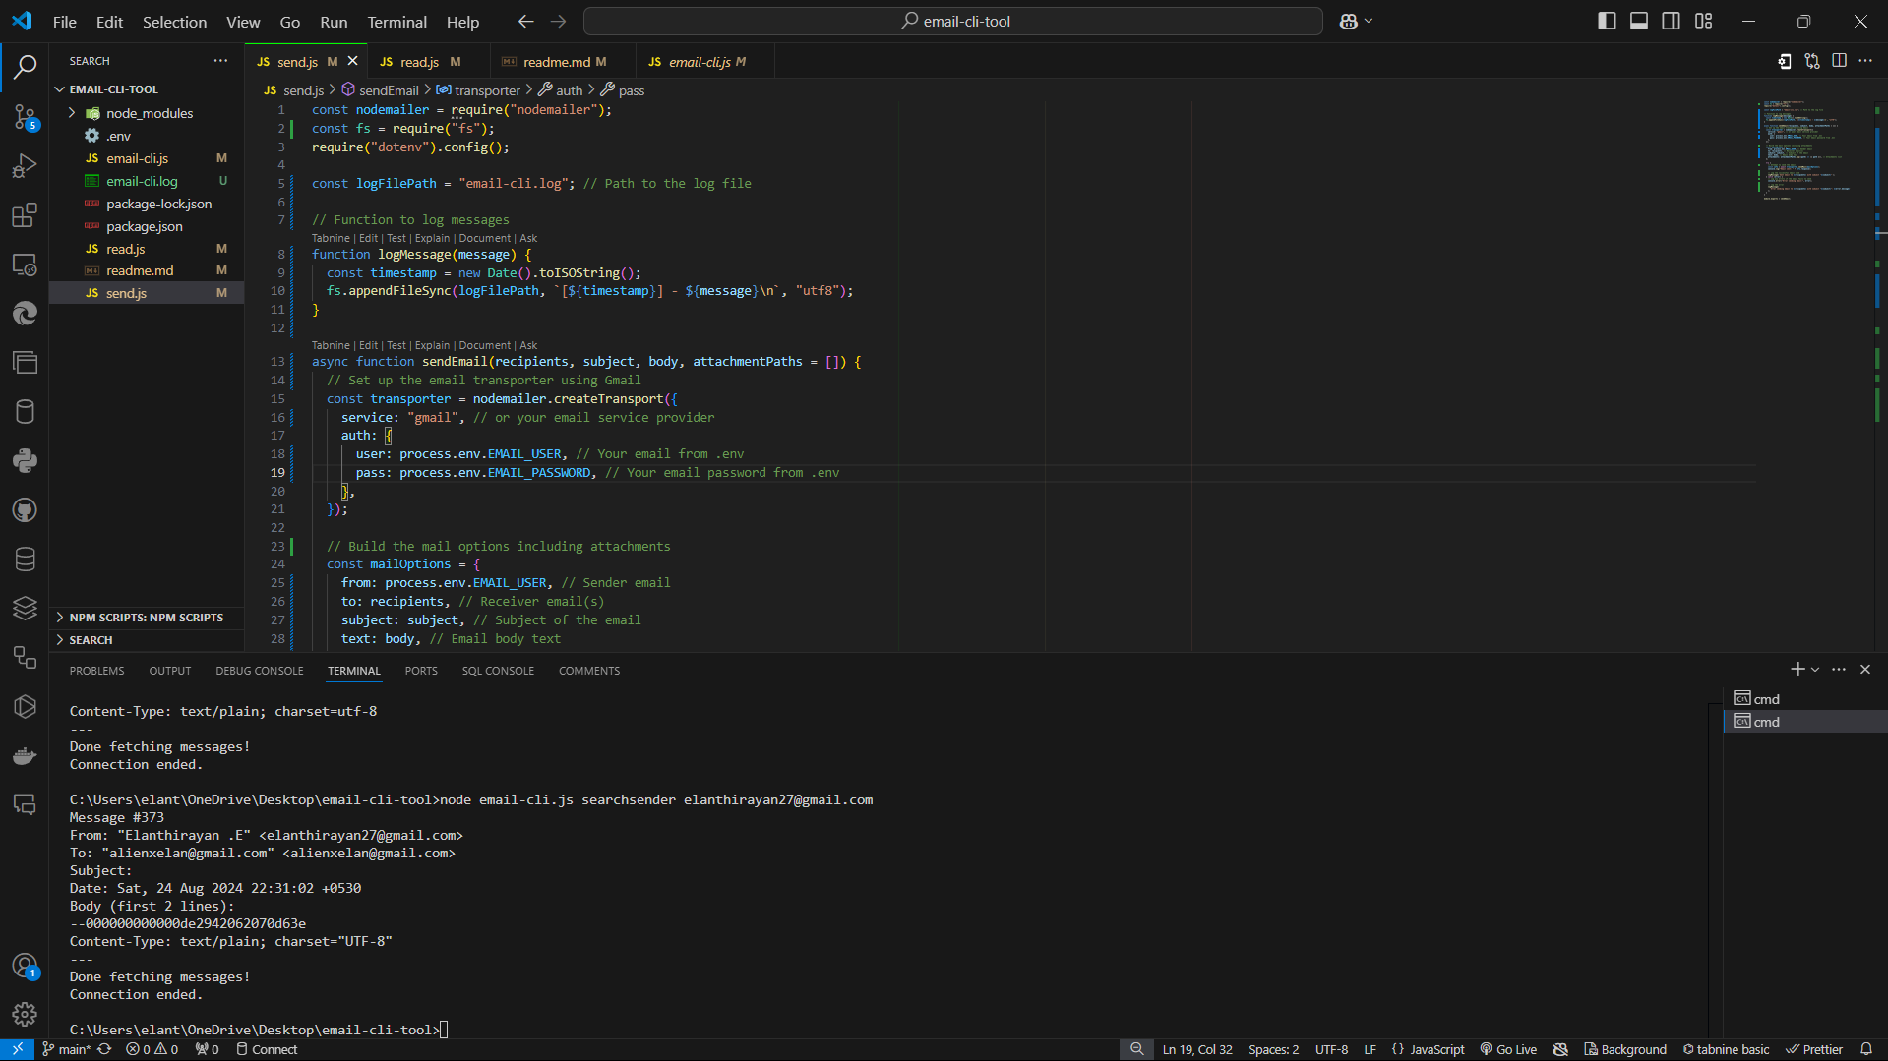
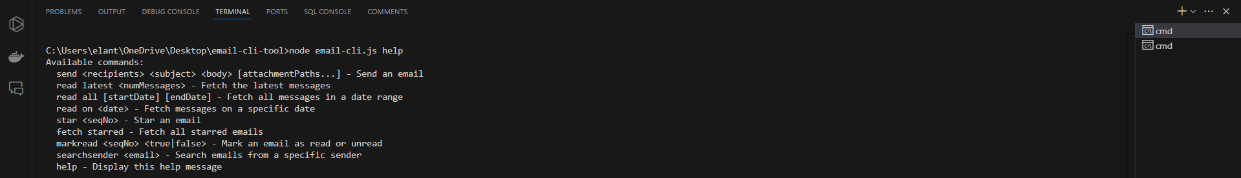
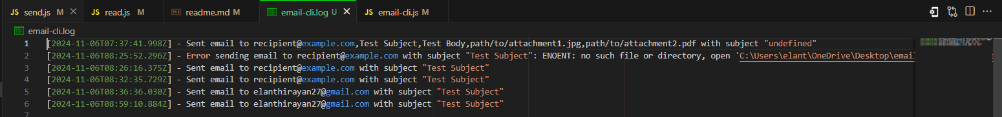
SEARCH MAILS BY USER MAILID
SEARCH MAILS BY USER MAILID
LOCAL STORAGE LOG FILE MAILS SEND

Slide 13
REFERENCE
[1] T. Valentine, ''Scripted Email: Using sendmail,'' in Apress, 2023, pp. 161-169, doi: 10.1007/978-1-4842-6460-3_11.
[2] L. Hu, ''A Design of an SMTP Email Server,'' Journal of Emerging Research in Applied Science and Engineering Technology, vol. 8, no. 4, pp. 7932, 2024, doi: 10.26689/jera.v8i4.7932.
[3] D. Xie, ''Mail management method and system,'' International Journal for Research in Applied Science and Engineering Technology, vol. 5, no. 4, pp. 1132-1141, 2018.
[4] P. Letmathe, E. Noll, ''Analysis of email management strategies and their effects on email management performance,'' RWTH Aachen University, 2022, doi: 10.1016/j.jcjp.2023.102411.
[5] M. E. Cecchinato, J. Bird, A. L. Cox, ''Personalised email tools: a solution to email overload?'' in Personalizing Behavior Change Technologies: CHI 2014 Workshop, ACM Conference on Human Factors in Computing Systems (CHI): Toronto, Canada, 2014.

Slide 14

THANK YOU…

